Slide 1
Project on: Food Waste Management
Presented By
Supervised By:
Jannatul Ferdaous
Lecturer, Dept. of CSE,
European University of Bangladesh
Name | ID
Saiful Islam Rishad | 190122051
M Sazzad Sultani Roksi | 190122063
Rifatul Islam | 190122041
Tariqul Islam Rifat | 190122050
Most. Sima Akter | 190122015
Thursday 4th April 2022

Slide 2
Outline
Introduction
Related Works
Motivation
Objectives
Requirement Collection and Analysis
Use Case Modeling and Description
Logical Data Model
Proposed Diagram
Approach
Features
Advantage and Disadvantage
Conclusion

Slide 3
Introduction
Food Waste Management is an online software system of donating food to the foodless people around the country.

Slide 4
Related Works
Some of the examples of similar applications of Food Waste Management are nosh, OLIO, ShareTheMeal: Charity Donate etc.
OLIO | nosh | ShareTheMeal: Charity Donate
OLIO gives the opportunity to share food and item's preventing waste and saving money. It serves free stuff, borrow things, and shop homemade directly from neighbors. | With the nosh app, you can now track your food inventory, medicines and expiry date or use by or best before date while you get recipe suggestions on your food inventory. | This is a charity app from the World Food Program that allows you to feed a hungry child with a tap on your phone.

Slide 5
Motivation
There are many foodless people around the country. They can hardly afford food for their family and themselves as well. So we took a step to reach food to those helpless people from the wasted food of restaurant, community centers and party centers.

Slide 6
Objective
Doners will post the food detail, pick location address, quantity of people available for donated food
Our agents will buy or take those foods from the pick address and reach to the foodless people

Slide 7
Requirement Collection and Analysis
View Food Posts
Collect food from donor
Deliver those foods to poor people
Agent
Register as donor
Create food post
Handover foods to out agents
Donor
Figure: Requirement Collection and Analysis.

Slide 8
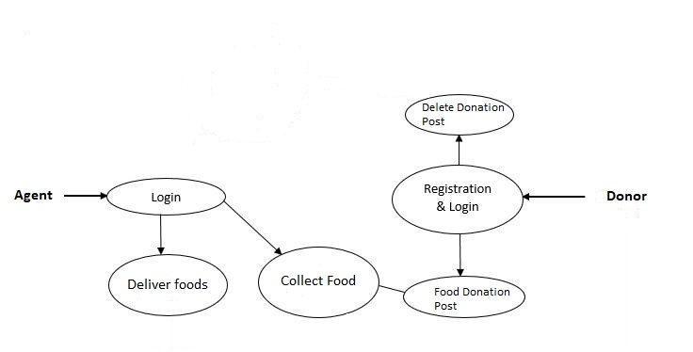
Use Case Modeling and Description
Figure: Use Case Modeling and Description

Slide 9
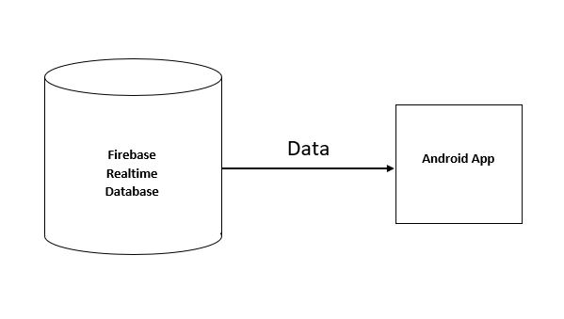
Logical Data Model
Figure: Logical Data Model

Slide 10
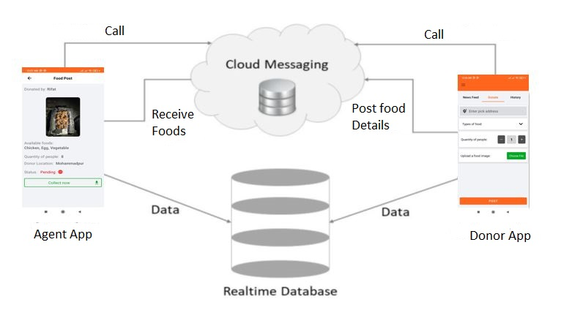
Proposed Diagram
Figure: Proposed Diagram

Slide 11

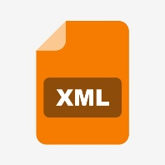


Approach
Platform/Framework | Backend Language | GUI | Database
Native Android with Android Studio | Kotlin | XML | Firebase

Slide 12
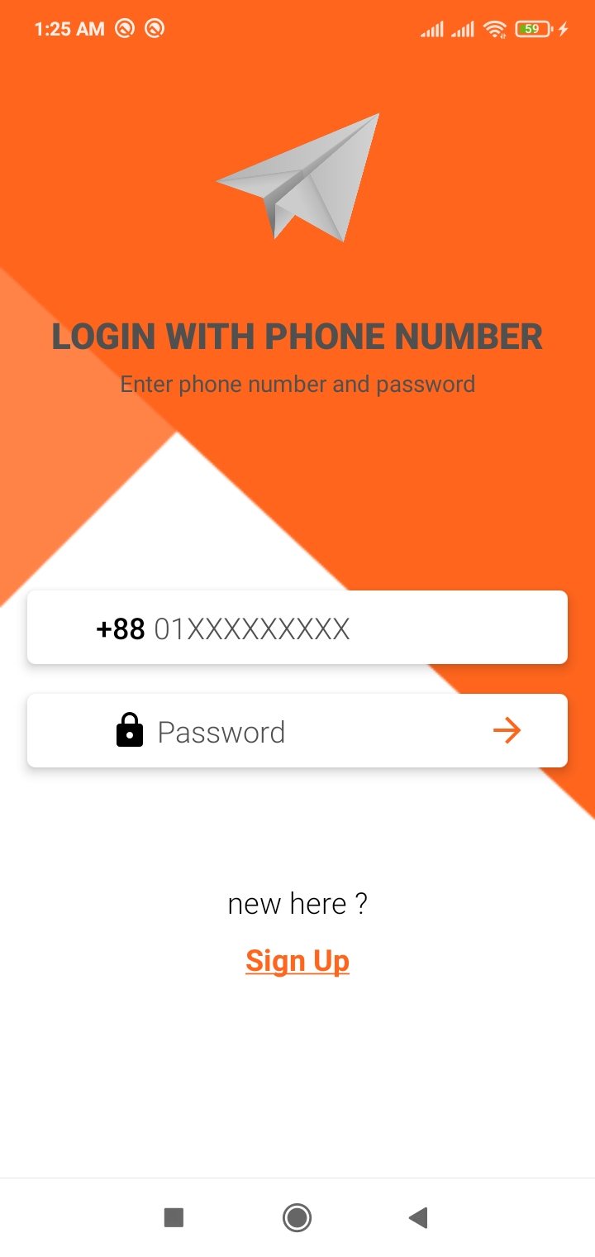
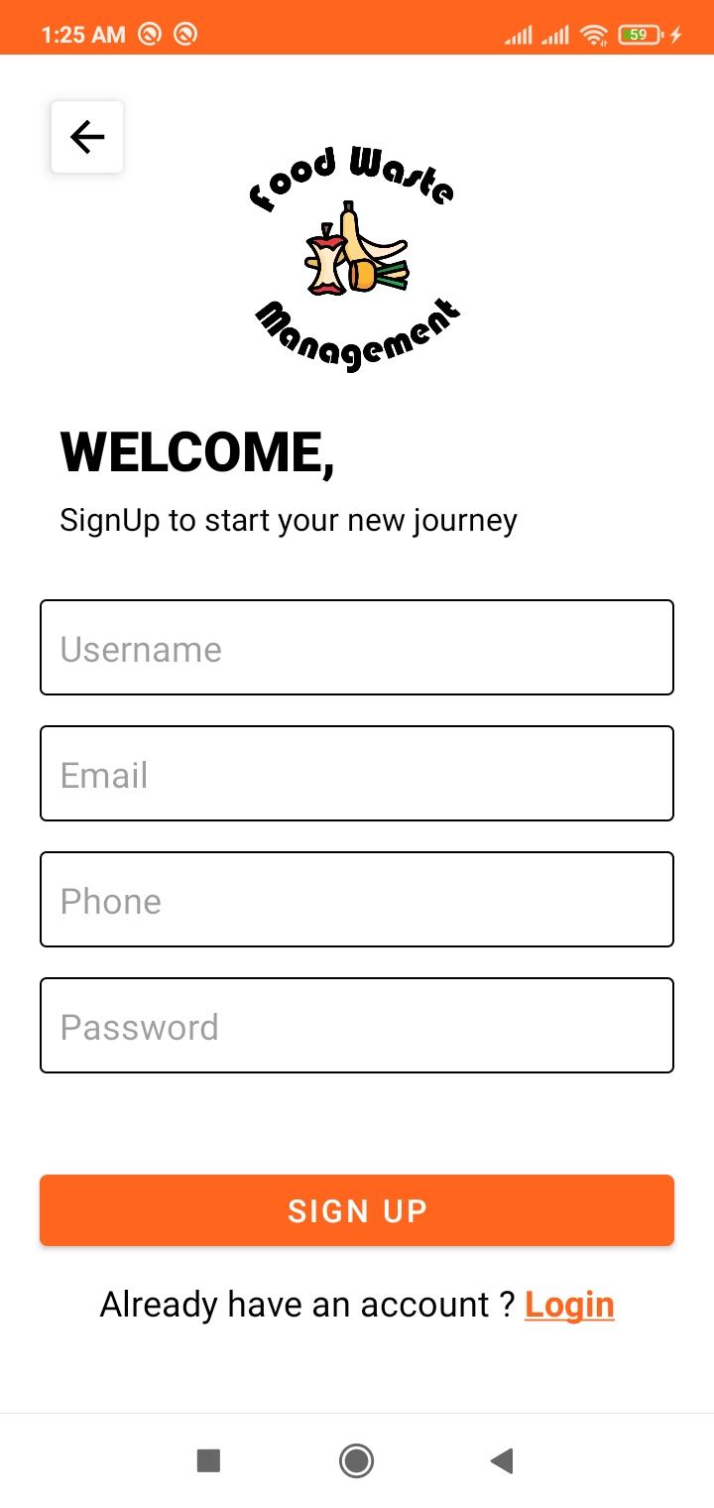
How the proposed system will work (Feature)
Figure: Login
Figure: Signup

Slide 13
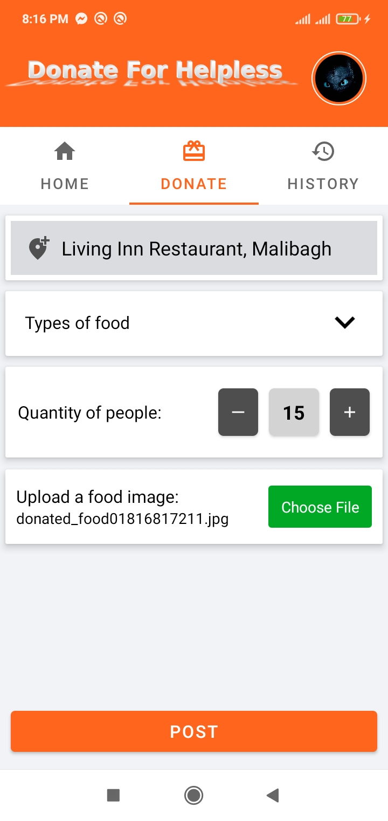
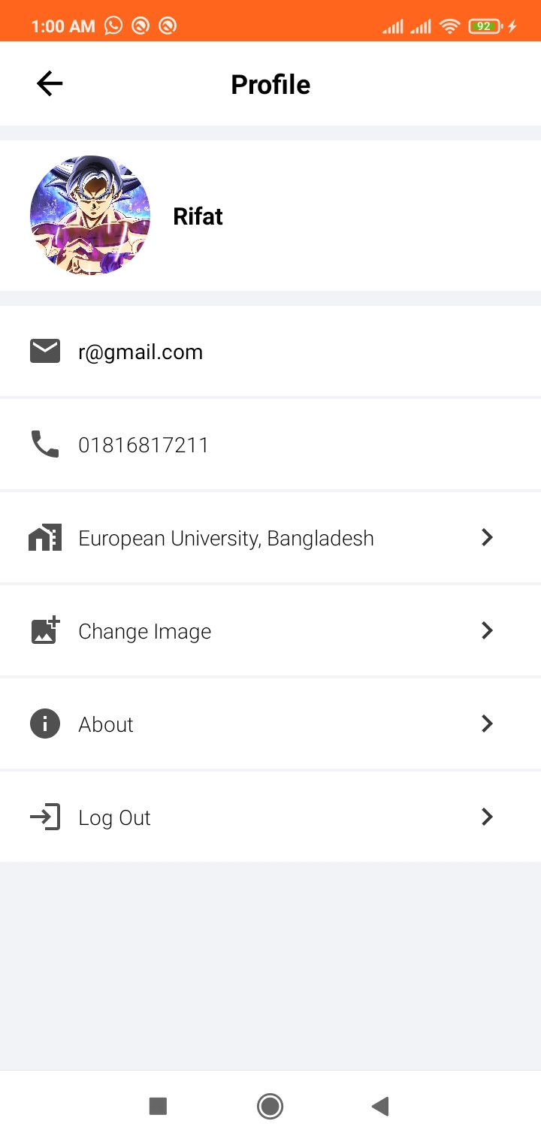
Features (Continued)
Figure: Donate Food
Figure: Profile

Slide 14
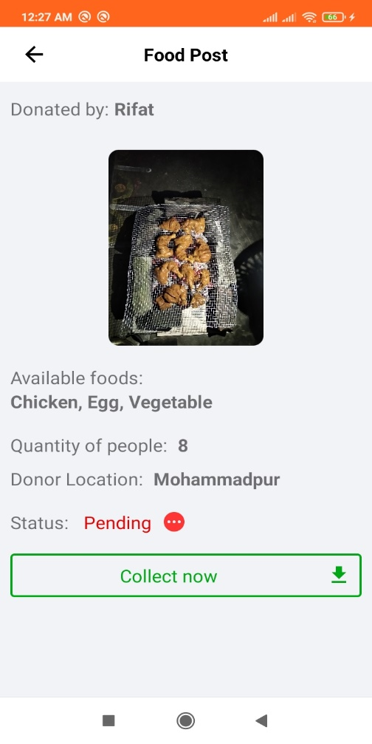
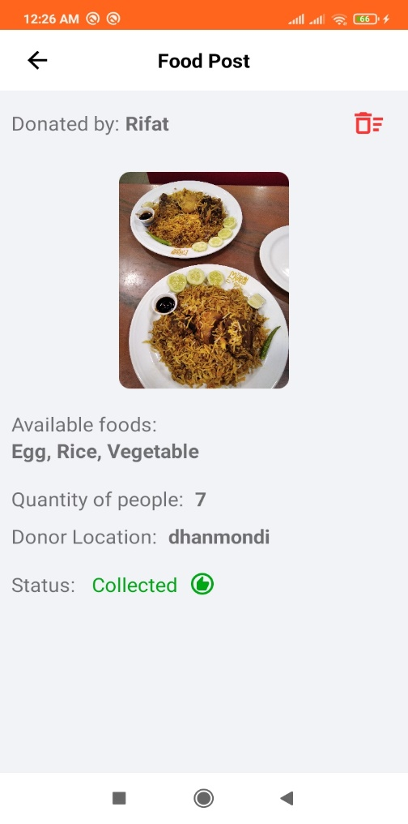
Features (Continued)
Figure: Pending Food Post
Figure: Collected Food

Slide 15
Advantage and Disadvantage
Advantage
This application will be beneficial for people of all occupations and ages. Users can perform a role to help poor and foodless people of this society through this application.
Disadvantage
During the development of the application, we have faced a lot of obstacles and successfully overcame most of them. Some of the obstacles were:
We had to learn firebase and cloud storage for database.
Getting the response from Database and display according to the design of the app.

Slide 16
Conclusion
The objective of this project was to implement approaches to waste management in the foodservice industry with the aim to identify innovations and to discuss their implications for food waste management. A key finding is that many companies are not actively innovating in the waste domain. They are however increasingly aware of the economic and social importance of food waste management. As the study shows, there are only a few low- or zero-waste restaurants. This application consequently provides agents to deliver food to poor, approach to waste issues pertaining to food service firms.

Slide 17
Thank you

